Slide 1
Practical Neural Networks

Slide 2
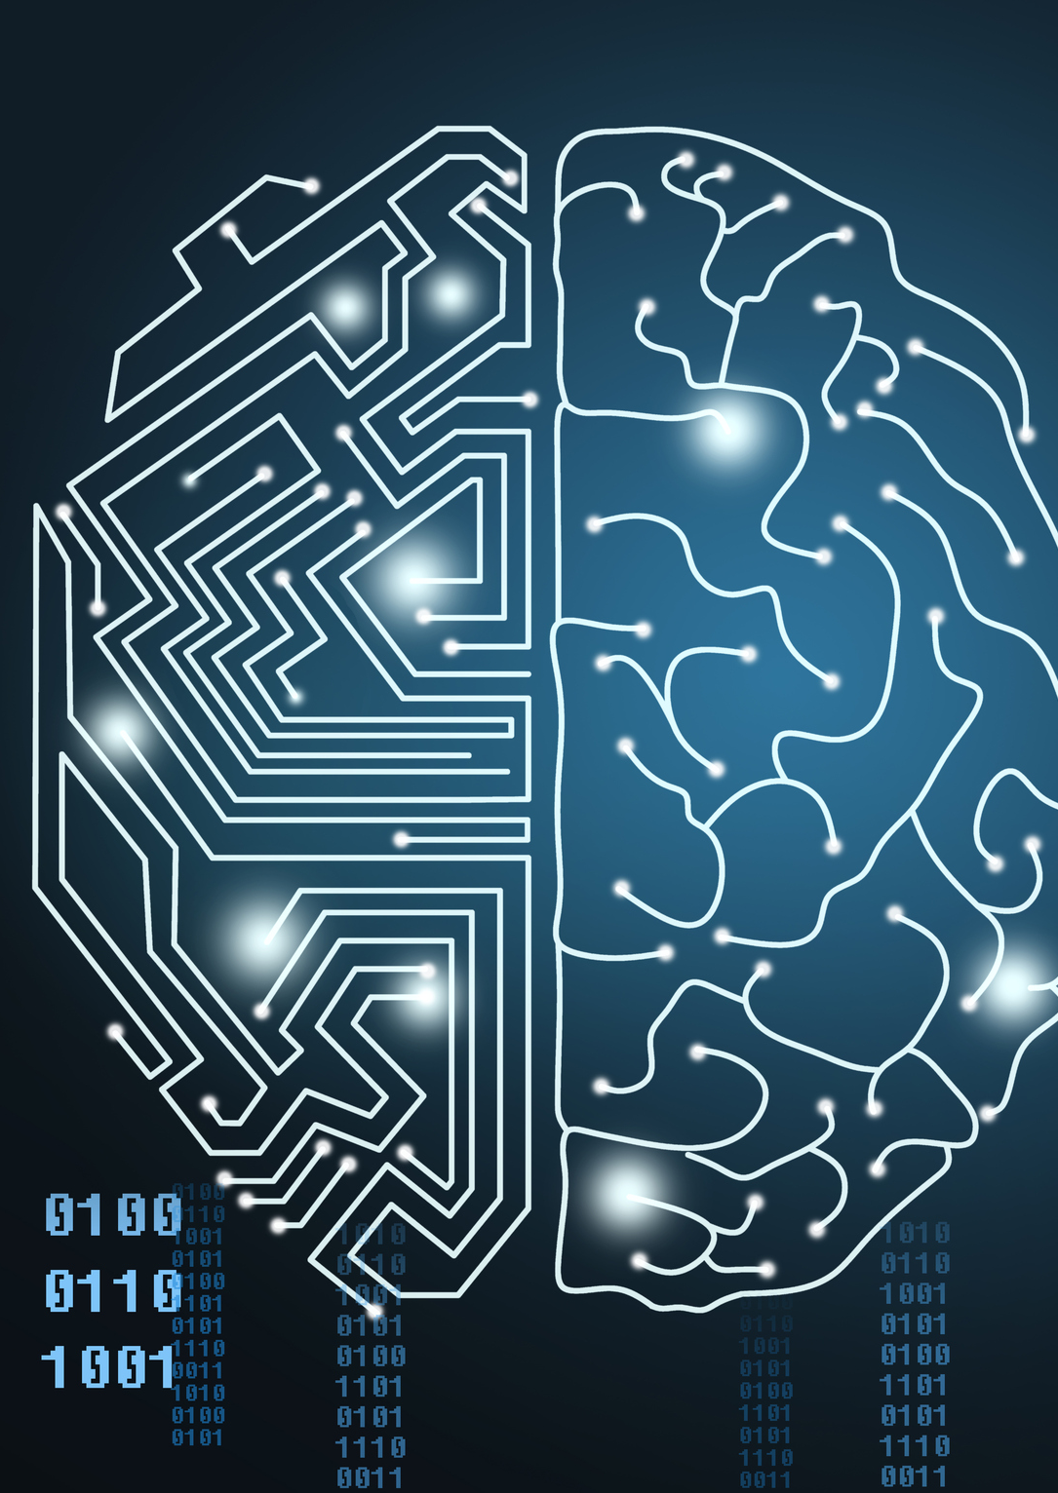
What are neural networks?
Neural networks are a set of algorithms, modeled loosely after the human brain, that are designed to recognize patterns.
They interpret data through labeling or clustering raw input.
The patterns they recognize can be images, sound, text or time series, must be translated
They can cluster, classify, or regression
There are supervised and unsupervised learning

Slide 3
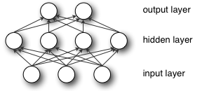
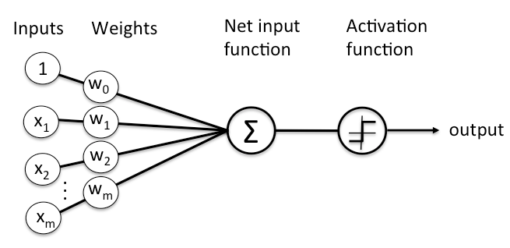

Artificial Neural Networks != Brain
The main goal of supervised learning is to find the relationship of:
$y=f\left(x\right)$
This can also be though as mapping a multidimensional space to another multidimensional space
The function f(x) can contain multiple operations to the input. This can be feature combination (tensor multiplication), non-linear functions (tanh).

Slide 4

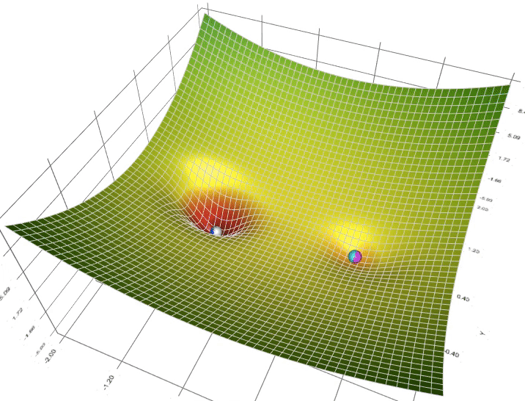
How do ANN learn?
In supervised learning, the network learn by example. This means that for every input, we know the exact output
A loss is minimized to train the network over several epochs
Using backpropagation, the gradients (equivalent to the derivative) are calculated and the weights are modified accordingly
There are several optimization algorithm, neither is better than the other one

Slide 5
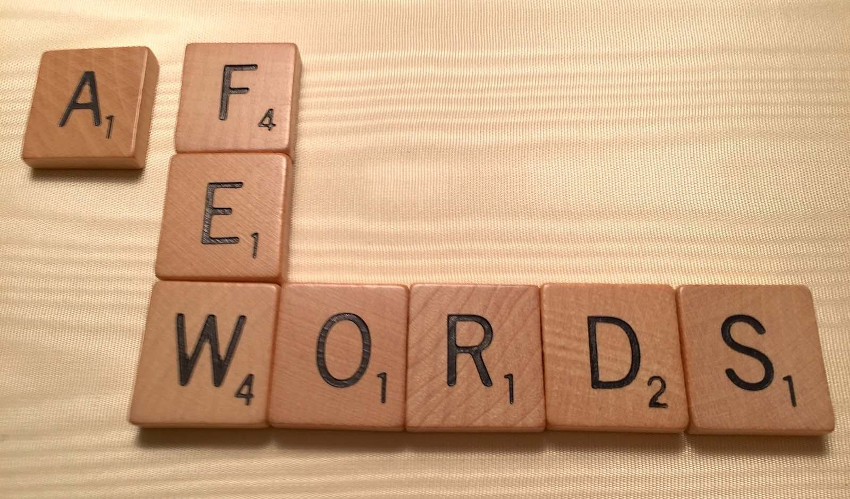
What type of architecture do I use?
Fully-Connected (Simple data, no time series)
Convolutional NN (Images, multidimensional data, time series)
Recurrent NN (time series, language)
Combine different types (All of the above)
What parameters do I need to define/tune:
Number and type of layers
Units (Neurons) per layer
Connections (for more advanced and deeper networks)
Loss to use (mse, cross entropy, etc)

Slide 6

OK Cool. Now I Want to Make One Myself
But first… Hyperparameters:
Epoch: every time the training goes through all the samples
Training epochs: This is the hardest to set. More is better, unless there’s overfitting (the model memorizes the training and doesn’t generalize)
Learning rate: usually smaller is safer, but it can take longer to train
Batch size: this is how many examples we use per optimization step. The bigger the batch, the training steps is more like the population and trains faster. But we have less training steps per epoch

Slide 7

I Use Tensorflow…
Tensorflow + Keras makes NN fun and easy. Common layers, functions, losses, and optimizers are readily programmed and validated
Great community support
Google $$$ means development is fast. But everything is open source
Fast for programming and executing
Easy deployment to desktops, web, mobile phones, embedded hardware

Slide 8
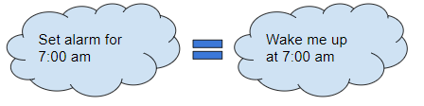
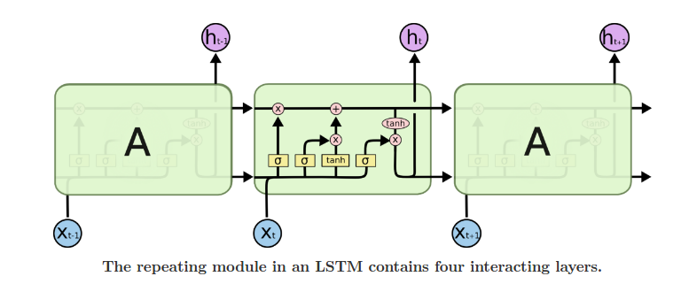
Recurrent Neural Networks
Recurrent → looks into the past to predict the output
It’s capable of “forgetting” irrelevant information
Great for time series, were each sample is related to the others
Commonly used for contextual speech recognition and language translation

Slide 9
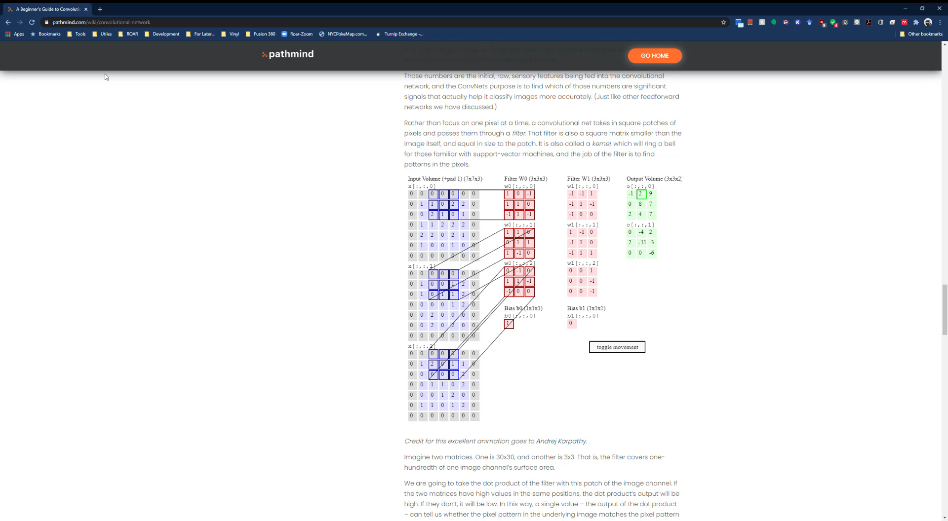
Convolution Neural Network
Convolution is a mathematical operation that’s used in single processing to filter signals and find patterns in signals
In a convolutional layer, all neurons apply convolution operation to the inputs. The most important parameter in a convolutional neuron is the filter size
Read more here

Slide 10
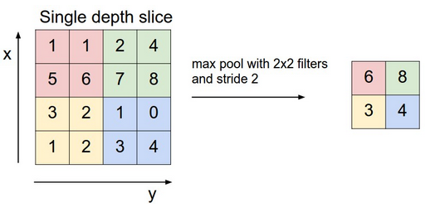
CNN++
Usually after a convolution, max pooling is done. This is we divide the tensor into subtensors and only the largest value is kept
For classifiers, the last layer uses a function called softmax. This functions creates a probability vector (the sum of all the elements of the vector is 1)

Slide 11
Useful links and fun things
For theory: https://www.deeplearningbook.org/
For easy tutorial: https://cv-tricks.com/
For interactive explanation: https://pathmind.com/wiki/convolutional-network
For bad jokes: https://amoudgl.github.io/blog/funnybot/
For playing with a bot: https://quickdraw.withgoogle.com/data
For community examples: https://experiments.withgoogle.com/collection/ai

